Slide 1
DA105.A (Monday)
Feel free to add comments. To use the slides, create a copy (file -> make a copy)

Slide 2
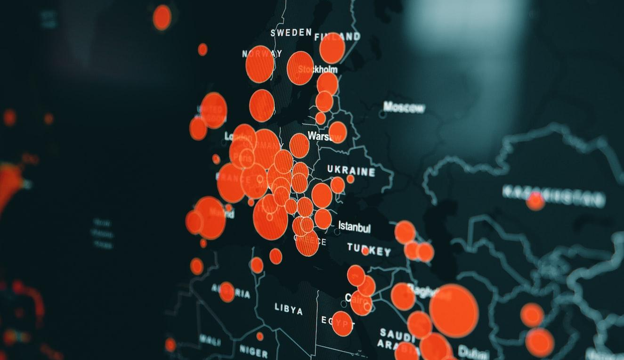

DA105 - Data Storytelling
Data Visualization at the WHO
While we're waiting to begin,
please answer in the Zoom chat:
What’s your favorite chart and why?

Slide 3
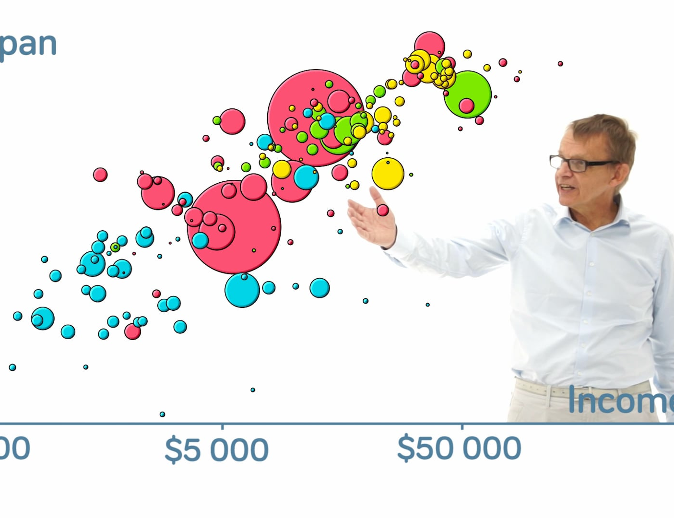
Data Visualization Intro
What we’ll cover today
The power of data visualization
WHO Mental Health Awareness Day
Visual encodings and perceptual hierarchy
Source: Gapminder

Slide 4

Today's Agenda
Power of data storytelling
20 min
World Mental Health Day
10 min
Visual encodings
15 min
Questions & Wrap-up
5 min

Slide 5
The Power of Data Storytelling

Slide 6
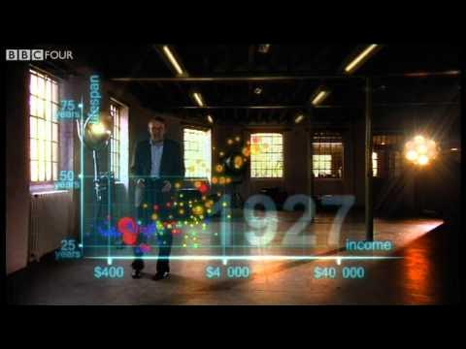

Hans Rosling’s 200 countries, 200 years, 4 minutes
The Joy of Stats
Hans Rosling (1948-2017):
Swedish physician, academic and public speaker
Chairman of the Gapminder Foundation
Promoted the use of data (especially visualization) to explore world development issues

Slide 7
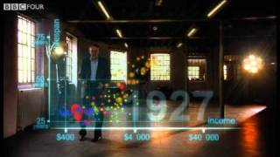
Notes:
https://www.youtube.com/watch?v=jbkSRLYSojo

Slide 8
Discussion
Raise your emoji hand to speak or type in the Zoom chat
What is one thing you took away from Hans’ visual story?

Slide 9
Discussion
What is one thing you took away from Hans’ visual story?
How much the world has changed in 200 years?
The difference between world regions as the result of colonization?
How many data points were in the story?
Hans’ compelling storytelling presence?

Slide 10
Discussion
Raise your emoji hand to speak or type in the Zoom chat
How did Hans show the average income and lifespan of each country?

Slide 11
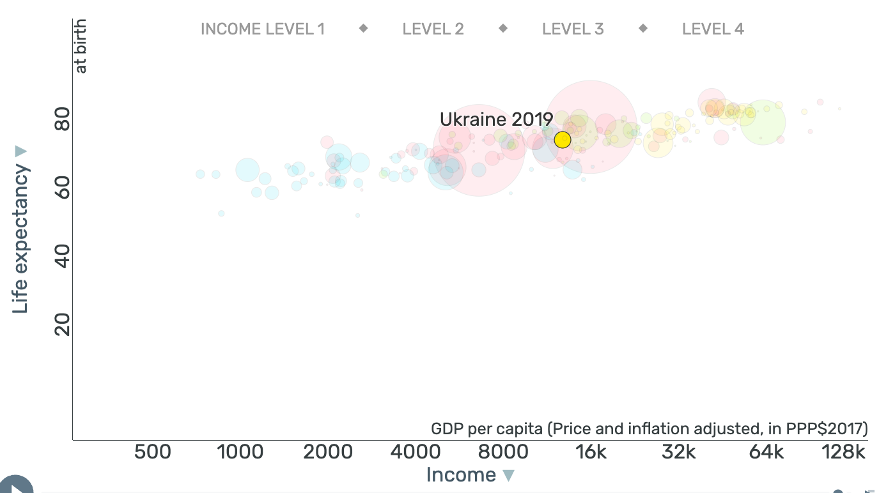
Discussion
How did Hans show the average income and lifespan of each country?
Position
73.8
13k
Notes:
Visual from Gapminder’s Bubbles tool: https://www.gapminder.org/tools/#$chart-type=bubbles&url=v1

Slide 12
Discussion
Raise your emoji hand to speak or type in the Zoom chat
How did Hans show the region each country belongs to?

Slide 13
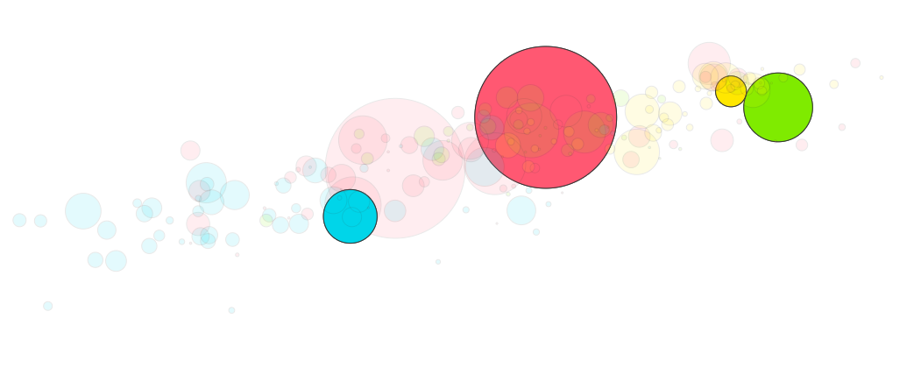
Discussion
How did Hans show the region each country belongs to?
Color
Red: Asia
Yellow: Europe
Green: Americas
Blue: Africa
Notes:
Visual from Gapminder’s Bubbles tool: https://www.gapminder.org/tools/#$chart-type=bubbles&url=v1

Slide 14
Discussion
Raise your emoji hand to speak or type in the Zoom chat
How did Hans show the population of each country?

Slide 15
Discussion
How did Hans show the population of each country?
Size
China: 1.42B
UK: 67M
USA: 334M
Nigeria: 203M
Notes:
Visual from Gapminder’s Bubbles tool: https://www.gapminder.org/tools/#$chart-type=bubbles&url=v1

Slide 16
Discussion
Raise your emoji hand to speak or type in the Zoom chat
How did Hans show changes over time?

Slide 17
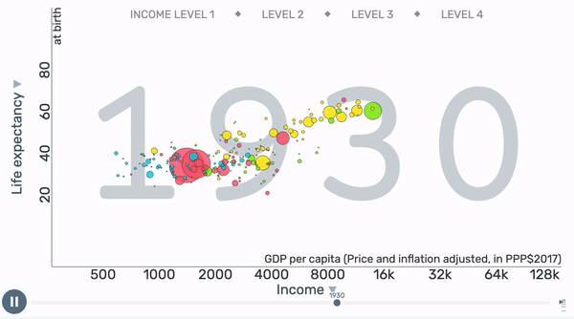
Discussion
How did Hans show changes over time?
Animation
Notes:
Animation from Gapminder’s Bubbles tool: https://www.gapminder.org/tools/#$chart-type=bubbles&url=v1

Slide 18
Discussion
Raise your emoji hand to speak or type in the Zoom chat
How did Hans communicate the main events in the story of the last 200 years?

Slide 19
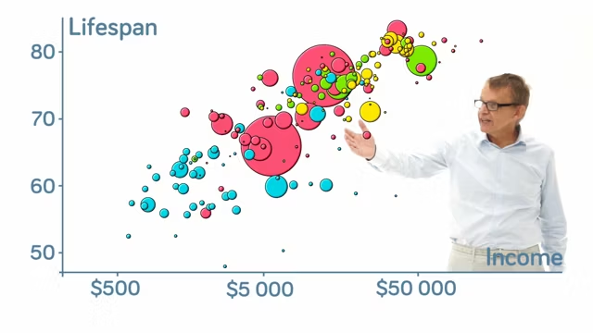
Discussion
How did Hans communicate the main events in the story of the last 200 years?
Verbal commentary

Slide 20
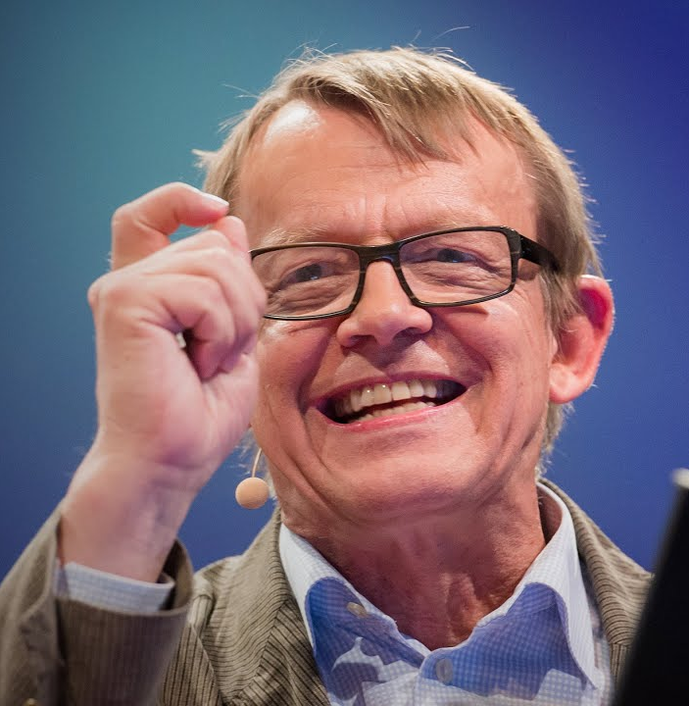
“
The world cannot be understood without numbers. But the world cannot be understood with numbers alone.
Hans Rosling

Slide 21
What questions do you have?
Feel free to raise your emoji hand or type into the chat.

Slide 22
World Mental Health Day

Slide 23

Raise awareness of mental health issues around the world
Mobilize efforts in support of mental health
Notes:
https://www.who.int/campaigns/world-mental-health-day

Slide 24





DA105 Business Case
Week 1
Key Messages & Social Media
Week 2
Marketing Budget Analysis
Week 3
Donor Presentation
Week 3
Dashboard & Infographic

Slide 25

This month you are:
Communications Associate
Marcus Patel
Lives in the outskirts of Dublin, Ireland
His role originally focused on writing feature stories but switched to data journalism
Loves any crossroads of art and science – like data visualization!
Still not over the Game of Thrones series finale

Slide 26

Meet your manager:
Director of Communications
Dr. Emily Rivera
From San Juan, Puerto Rico
Moved to NYC for her Ph.D in Public Health, then to Geneva, Switzerland for the WHO 14 years ago
Promoted to this role 3 years ago and hired you!
A self-starter who recently taught herself and her 8-year-old daughter to make sourdough

Slide 27


Business Question
Support the campaign’s data needs
You’re taking this end-to-end!
WHO Internal
Emily Rivera
Hi Marcus!
As we discussed during our 1:1 meeting, we have 2 months before the World Mental Health Day campaign kicks off. We need all of our data assets to be complete at least a month ahead, and there’s a lot to do.
Key deliverables:
• Visualizations for social media posts
• Marketing budget allocation analysis
• Data for donor presentation
• Dashboard for our campaign landing page
I know you can do it. Let me know if you have any questions!
Running a large-scale awareness campaign has a lot of different data analysis needs.
There are materials for the campaign itself (social media posts, dashboards) as well as operational needs (analyses, presentations).
Looks like you’ll be busy this month!
Marcus Patel (You)
Emily Rivera

Slide 28
Visual Encodings

Slide 29

The campaign’s key messages
Source: World Health Organization
Close to one billion people have a mental disorder.
On average, countries spend just 2% of their national health budgets on mental health.
For every $1 USD invested in treatment for depression & anxiety, there is a return of $5 USD.
Notes:
https://www.who.int/key-messages

Slide 30
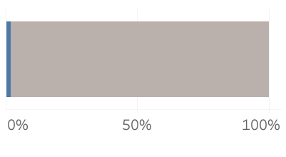
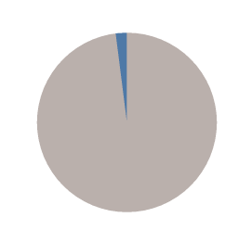
Which chart is better? Why?
Raise your emoji hand to speak or type in the Zoom chat
On average, countries spend just 2% of their national health budgets on mental health.
2%
2%
Notes:
Let’s have a quick discussion. Which of these charts do you think is better and why? They both show the percentage of health budgets spent on mental health. Can you describe what makes them different?

Slide 31
Length vs. Angle
On average, countries spend just 2% of their national health budgets on mental health.
2%
2%
The value is represented by the length of the bar
The value is represented by the angle of the slice
Notes:
The difference between the bar chart and the pie chart is that the bar chart represents the 2% value as the length of the blue part of the bar, and the pie chart represents the 2% as the angle of the blue slice. They both show the same information but represented in a different visual way.

Slide 32
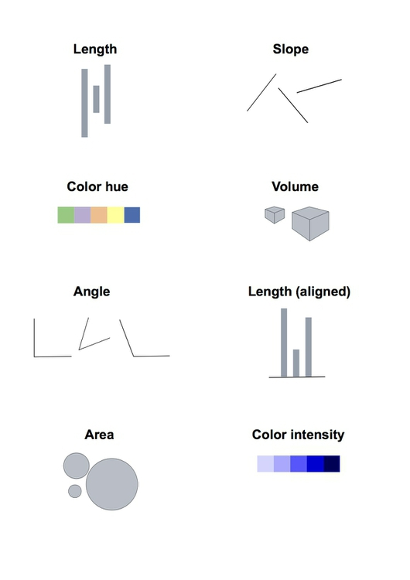
Length and angle are visual encodings
These are the primary ways we can map data to visual elements
Image source: Peter Aldhous
Notes:
When we take data and create a chart, we are using visual encodings. Visual encodings are how we map data values to graphical elements that can be interpreted visually. So in the previous example, length is the visual encoding used in the bar chart, while angle is the visual encoding used in the pie chart. We could also use the slope of a line, to show what direction something is going. There are also area and volume of shapes, like circles or cubes, that can show a quantity. And of course, there’s color. There’s the hue, like red or blue, and the intensity or saturation. These are the components we are using to construct charts at the foundational level.

Slide 33
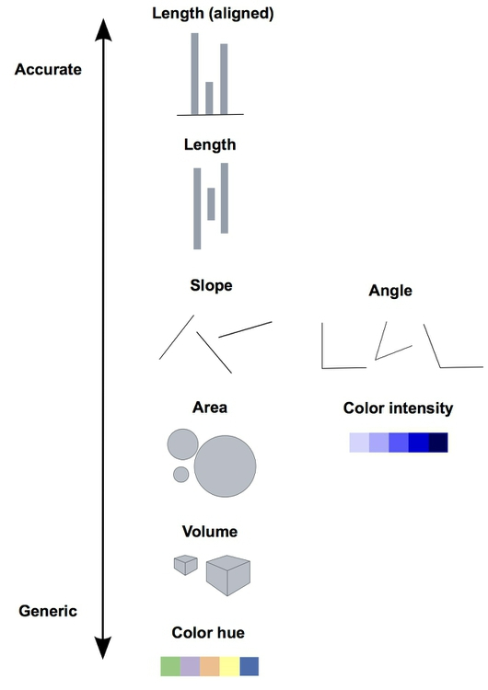
Perceptual Hierarchy
The goal is to use encodings as high up on the hierarchy as possible
The human brain processes some encodings faster and more accurately than others
In the 1980s, this was tested by statisticians William S. Cleveland and Robert McGill
Image source: Peter Aldhous
Notes:
So are these all the same? Does it matter which ones we use? This has been studied in statistics and psychology, and what they found is that it does matter. The human brain can process some of these visual encodings faster and more accurately than others. When this was put to the test, a hierarchy emerged, which is shown in this picture. Encodings at the top of the hierarchy were easier for people to tell the differences between different values. This matters a lot, because the reason we create charts is to convey information. So anything we do to make it faster and easier for people to understand our charts, the clearer our message will be. We always want to prioritize encodings that are higher up on the hierarchy, if we have the choice.

Slide 34
Length > Angle
Length is higher than angle on the perceptual hierarchy
On average, countries spend just 2% of their national health budgets on mental health.
>
2%
2%
The value is represented by the length of the bar
The value is represented by the angle of the slice
Notes:
So, back to our pie and bar charts. In this case, the bar chart would be more effective than the pie chart, because length is higher on the perceptual hierarchy than angle. This is a very simple chart, so the difference is not huge. But you can imagine that the more categories we have, the more this difference matters.

Slide 35
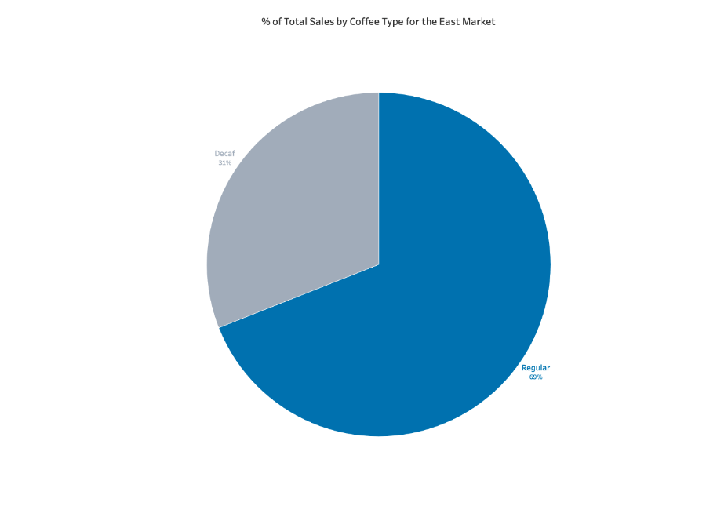
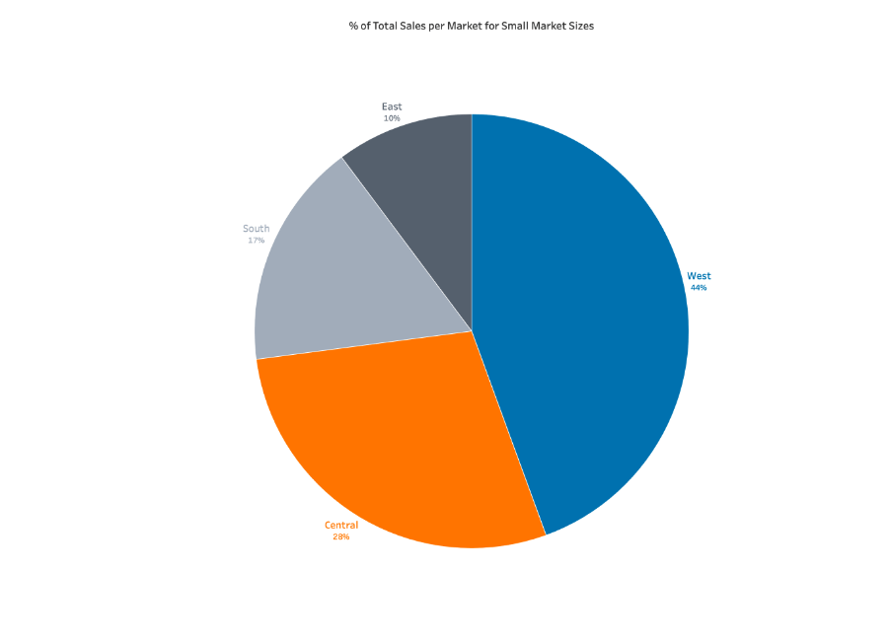
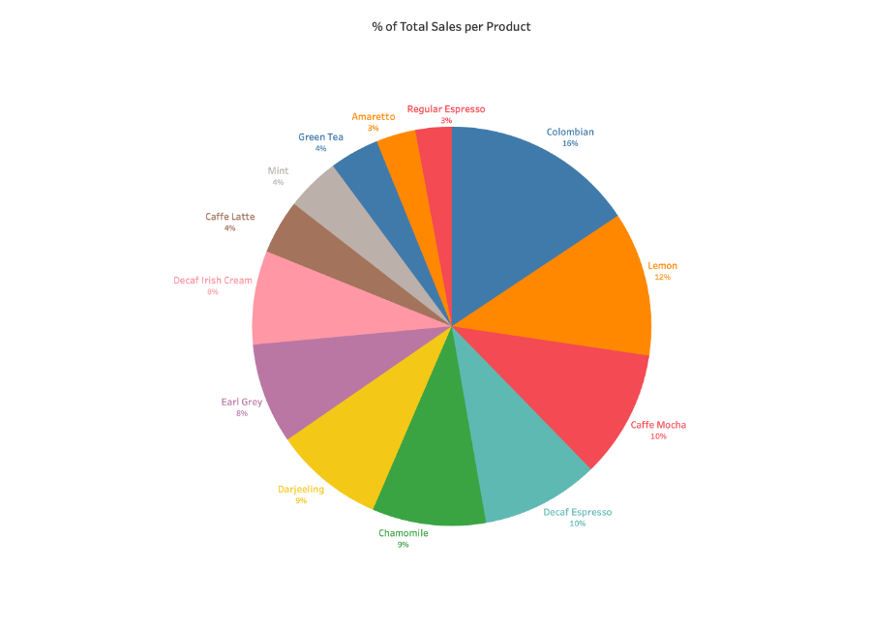
So no pie charts?!
You can always replace a pie chart with a bar chart, but sometimes pie charts are fine.
Good
Okay
Bad
2-3 categories with very different values
4-6 categories with fairly different values
7+ categories with indistinguishable values
Notes:
Sometimes, pie charts are okay. There is always the option to replace it with a bar chart. So if you are looking for a black-and-white rule, just use bar charts and forget about pie charts. But, people like pie charts. There’s something about them that is visually appealing. So if you are going to use pie charts, here are the situations where it works best. If you have 2-3 categories with very different sizes of the slices, then a pie chart is fine. If you have 4-6 categories and the slices are reasonably different, then pie charts are okay but not optimal. You should consider switching to a bar chart. If you have more than 7 categories, you probably won’t be able to tell a meaningful difference between the slices. Just avoid pie charts entirely here.

Slide 36
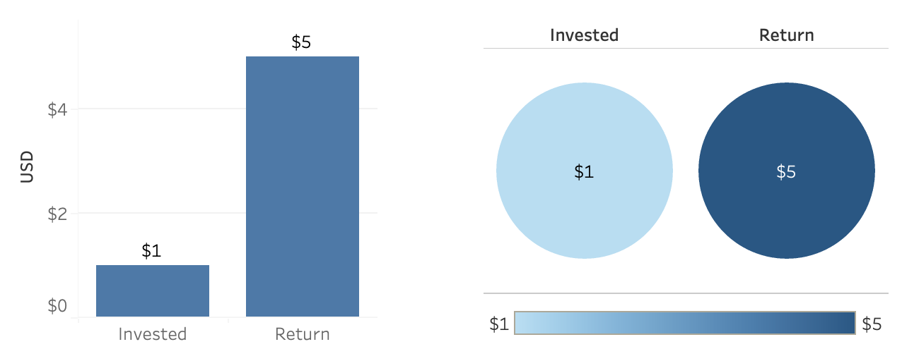
Which chart is better? Why?
Raise your emoji hand to speak or type in the Zoom chat
For every $1 USD invested in treatment for depression & anxiety, there is a return of $5 USD.
Notes:
Let’s do one more exercise to check our understanding of the perceptual hierarchy of visual encodings. Which one of these charts would be better? The first one shows the dollar values as bar lengths. The second one shows the dollar values as the intensity of the color. Which is optimized in terms of human visual perception?

Slide 37
Bar charts win a lot of the time 💪
Length is the highest on the perceptual hierarchy
For every $1 USD invested in treatment for depression & anxiety, there is a return of $5 USD.
>
Notes:
In this case, the bar chart is also better. Color hue and intensity fall to the lower half of the perceptual hierarchy. You’ll find that bar charts win a lot of the time, because length is the highest-ranking visual encoding.

Slide 38
What questions do you have?
Feel free to raise your emoji hand or type into the chat.

Slide 39

Wrap-up
Campus material is live and available 24/7.
Use Chat Bubble as much as you need!
Reach out w/ questions via Slack.
Next live session on Wednesday

Slide 40
Next up…
Week 1
Key Messages & Social Media
Week 2
Marketing Budget Analysis
Week 3
Donor Presentation
Week 3
Dashboard & Infographic
Wednesday’s topic: Visualizations for social media posts

Slide 41
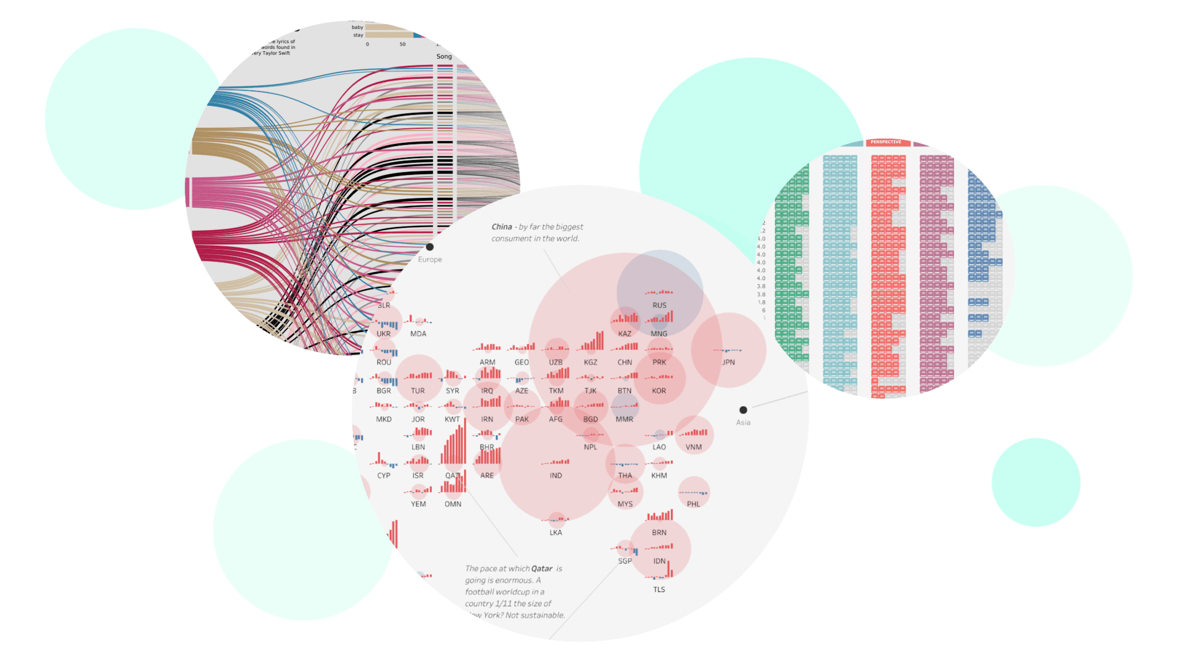
Instructions on Campus
Get started with Tableau Public
Create your account and install
You’ll need Tableau Public set up and ready to go before the next live session. ✅
Read the instructions in the first sprint on Campus: Getting Started with Tableau Public.

Slide 42
Thank You
And Keep Practicing!
Notes:
End of Presentation slide

